Slide 1
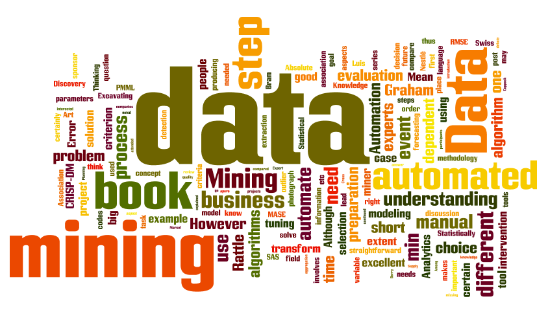
IT-533: Data Mining
Week 8
Sonja Streuber

Slide 2
Welcome Back! Classification—A Two-Step Process
1. Model construction:
describing a set of predetermined classes
Each tuple /sample is assumed to belong to a predefined class, as determined by the class label attribute
The set of tuples used for model construction is training set
The model is represented as classification rules, decision trees, or mathematical formulae
2. Model usage:
Classifying future or unknown objects
Estimate accuracy of the model
The known label of test sample is compared with the classified result from the model
Accuracy rate is the percentage of test set samples that are correctly classified by the model
Test set is independent of training set, otherwise over-fitting will occur
If the accuracy is acceptable, use the model to classify data tuples whose class labels are not known

Slide 3
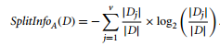
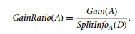
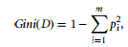
Welcome Back! Attribute Selection for Decision Tree Partitioning—C4.5
Information gain (ID3):
The difference between the original information requirement (i.e. based on just the proportion of classes) and the new requirements (i.e. obtained after partitioning on A).
Gain ratio (C4.5):
Gini index:
Measures the impurity of D, a data partition or set of training tuples as
Attribute with the highest information gain chosen as split attribute because it reflects the least randomness
Measured in bits
Gain(A) = Info(D)-Info_{A}(D)
Biased towards attributes with large numbers
.
Normalizes for attributes with large values by using Splitinfo parameter
.
.
.
Considers a binary split for each attribute

Slide 4
Welcome Back!
Classification and Prediction
Classification:
Classifies data (constructs a model) based on the training set and the values (class labels) in a classifying attribute and uses it in classifying new data
Models categorical values
Prediction:
Models continuous-valued functions, i.e., predicts unknown or missing values
Typical Applications
credit approval
target marketing
medical diagnosis
treatment effectiveness analysis
Supervised Learning
Unsupervised learning (clustering)
The class labels of training data is unknown
Given a set of measurements, observations, etc. with the aim of establishing the existence of classes or clusters in the data

Slide 5
Welcome Back!
Classification
(supervised learning)
Naïve Bayes Conditional Probability
Decision Tree
Quality Measurements:
Information Gain:
Information Needed (before splitting, entropy)– Information Needed (after splitting)
Measured in bits
Gain Ratio:
Information Gain/ SplitInfo

Slide 6
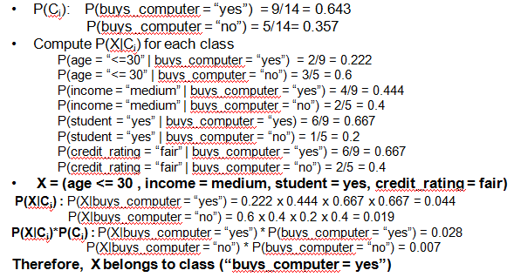
Welcome Back!
Classification
(supervised learning)
Naïve Bayes Conditional Probability
Decision Tree
Bayes Theorem:

Slide 7
Welcome Back!
Decision Trees
Naïve Bayes Classifier
Advantages:
Compact and easy to implement
Disadvantage:
Poor accuracy for unseen samples may require Prepruning (Halt tree construction early ̵ if goodness measure could fall below a hard-to-pick threshold)
Poor accuracy for unseen samples may require Postpruning: Remove branches from a “fully grown” tree—get a sequence of progressively pruned trees (requires multiple sets of test data)
Advantages:
Easy to implement
Good results obtained in most of the cases
Disadvantages
Assumption: class conditional independence, therefore loss of accuracy
Probability is non-zero!
Practically, dependencies exist among variables
E.g., hospitals: patients: Profile: age, family history etc
Symptoms: fever, cough etc., Disease: lung cancer, diabetes etc
Dependencies among these cannot be modeled by Naïve Bayesian Classifier
Overfitting: Too many branches based on training data, some may show anomalies

Slide 8
Welcome Back! Classifier Evaluation: Confusion Matrix
Confusion Matrix:
Actual class\Predicted class | C₁ | ¬ C₁
C₁ | True Positives (TP) | False Negatives (FN)
¬ C₁ | False Positives (FP) | True Negatives (TN)
Example of Confusion Matrix:
Actual class\Predicted class | buy_computer = yes | buy_computer = no | Total
buy_computer = yes | 6954 | 46 | 7000
buy_computer = no | 412 | 2588 | 3000
Total | 7366 | 2634 | 10000
Given m classes, an entry, CM_{i,j} in a confusion matrix indicates # of tuples in class i that were labeled by the classifier as class j
May have extra rows/columns to provide totals
8

Slide 9
Welcome Back! Classifier Evaluation
A\P | C | ¬C
C | TP | FN | P
¬C | FP | TN | N
 | P’ | N’ | All
Classifier Accuracy, or recognition rate: percentage of test set tuples that are correctly classified
Accuracy = (TP + TN)/All
Error rate: 1 – accuracy, or
Error rate = (FP + FN)/All
Sensitivity: True Positive recognition rate
Sensitivity = TP/P
Specificity: True Negative recognition rate
Specificity = TN/N
Example:
Actual Class\Predicted class | cancer = yes | cancer = no | Total | Recognition(%)
cancer = yes | 90 | 210 | 300 | 30.00 (sensitivity)
cancer = no | 140 | 9560 | 9700 | 98.56 (specificity)
Total | 230 | 9770 | 10000 | 96.40 (accuracy)
Precision = 90/230 = 39.13% Recall = 90/300 = 30.00%
9

Slide 10
Information gain—just incase
Another example if we have questions

Slide 11
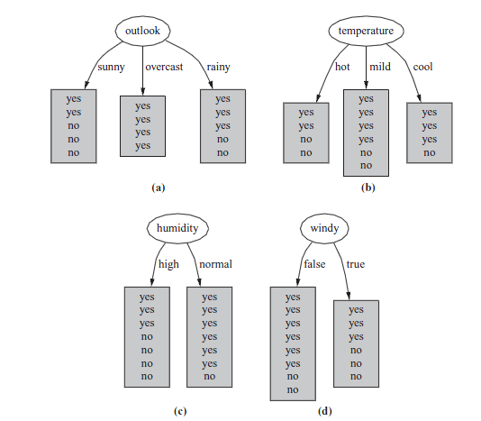
Attribute Selection and Information Gain
Information gain
Information gain increases with the average purity of the subsets
Strategy: choose attribute that gives greatest information gain
Measure information in bits
Given a probability distribution, the info required to predict an event is the distribution’s entropy
Entropy gives the information required in bits (& fractions)
Strategy: Get the smallest tree! → choose the attribute that produces the “purest” nodes
On which attribute should we split the decision tree?
Entropy(p₁,p₂,... ,p_{n})=
−p₁logp₁−p₂ logp₂ ...−p_{n}log p_{n}

Slide 12
Information Gain Example Calculations
Outlook = Sunny :
info([2,3])=entropy(2/5,3/5)=−2/5log(2/5)−3/5log (3/5)=0.971bits
2. Outlook = Overcast :
info([4,0])=entropy (1,0)=−1log(1)−0log(0)=0bits ← normally undefined
3. Outlook = Rainy :
info([2,3])=entropy(3/5,2/5)=−3/5log(3/5)−2/5log(2/5)=0.971bits
4. Expected information for attribute:
info([3,2],[4,0],[3,2])=(5/14)×0.971+(4/14)×0+(5/14)×0.971=0.693bits

Slide 13
Information Gain Example
Information gain: information before splitting – information after splitting
Information gain for attributes from weather data:
gain(Outlook ) = info([9,5]) – info([2,3],[4,0],[3,2])
= 0.940 – 0.693 = 0.247 bits
gain(Outlook ) = 0.247 bits
gain(Temperature ) = 0.029 bits
gain(Humidity ) = 0.152 bits
gain(Windy ) = 0.048 bits
Bigger is better!

Slide 14
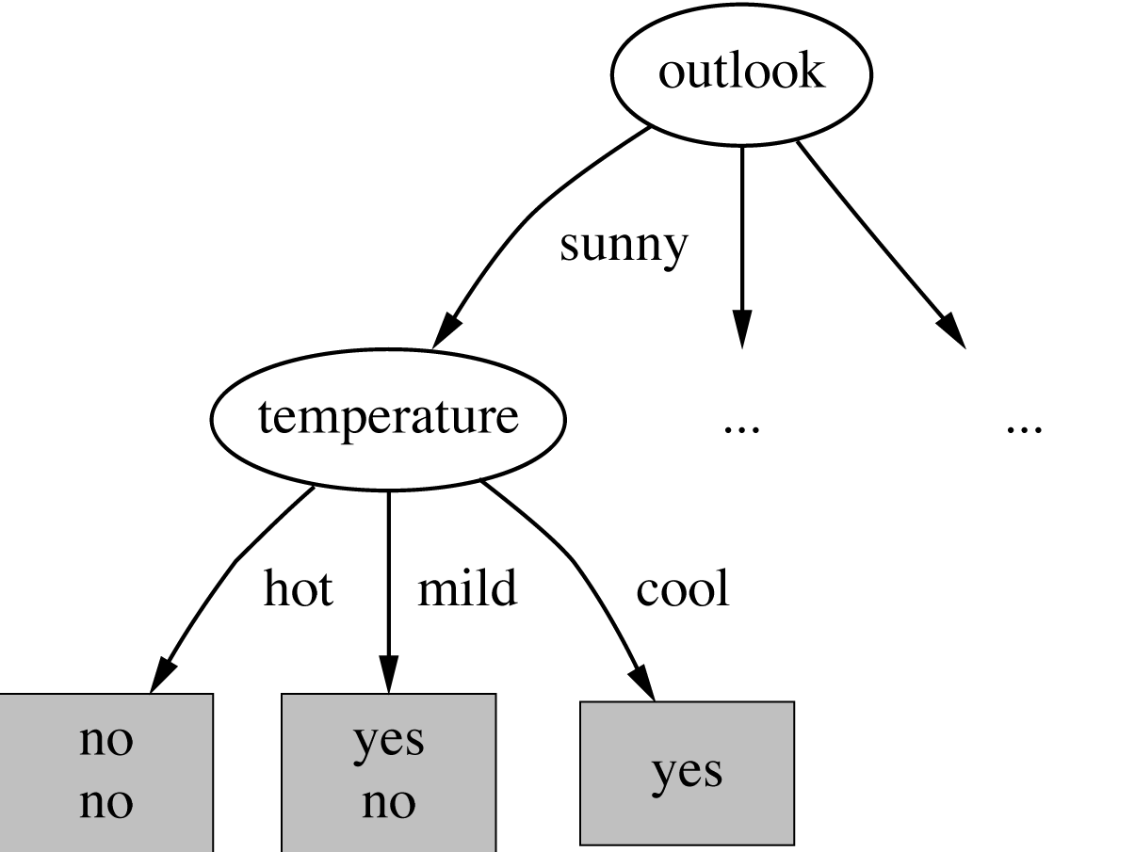
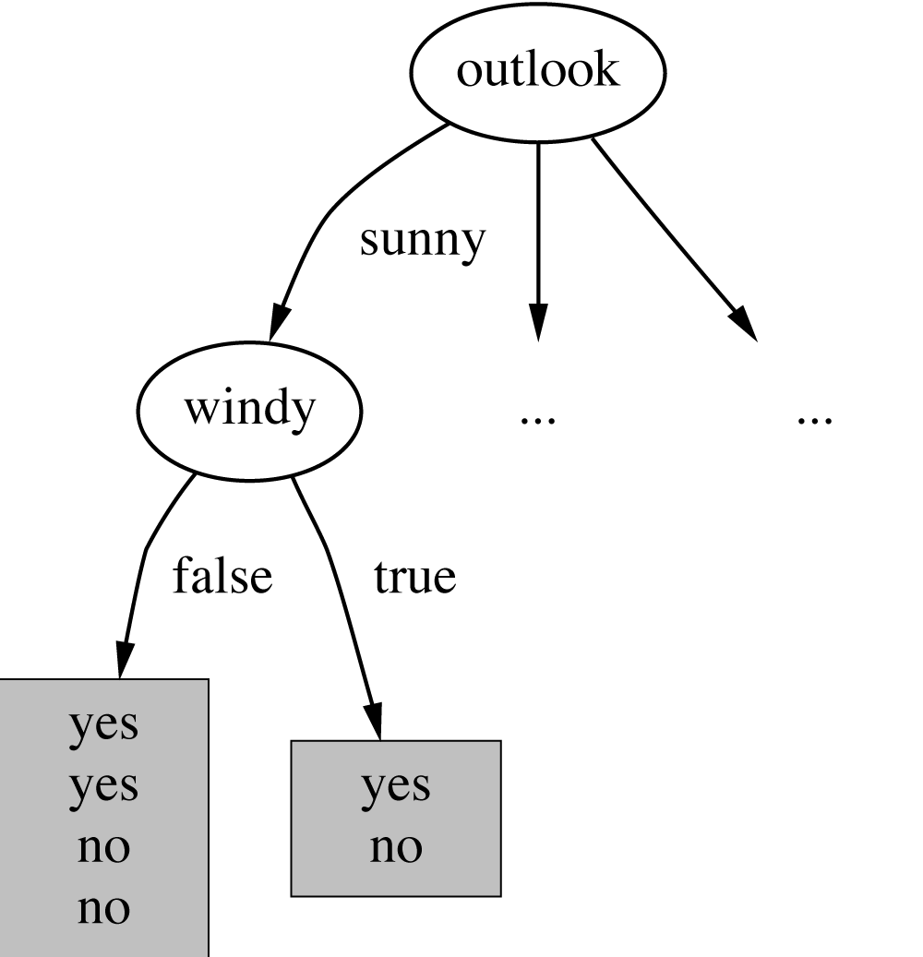
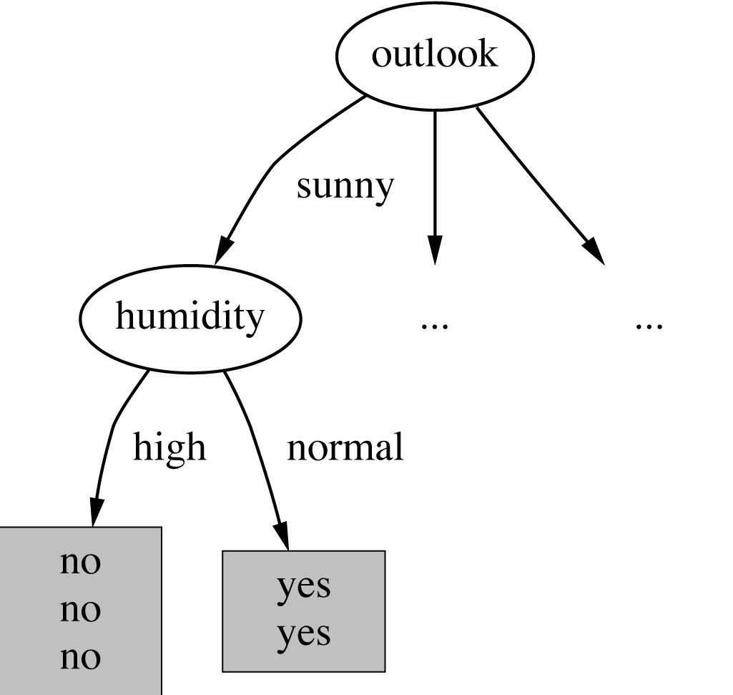
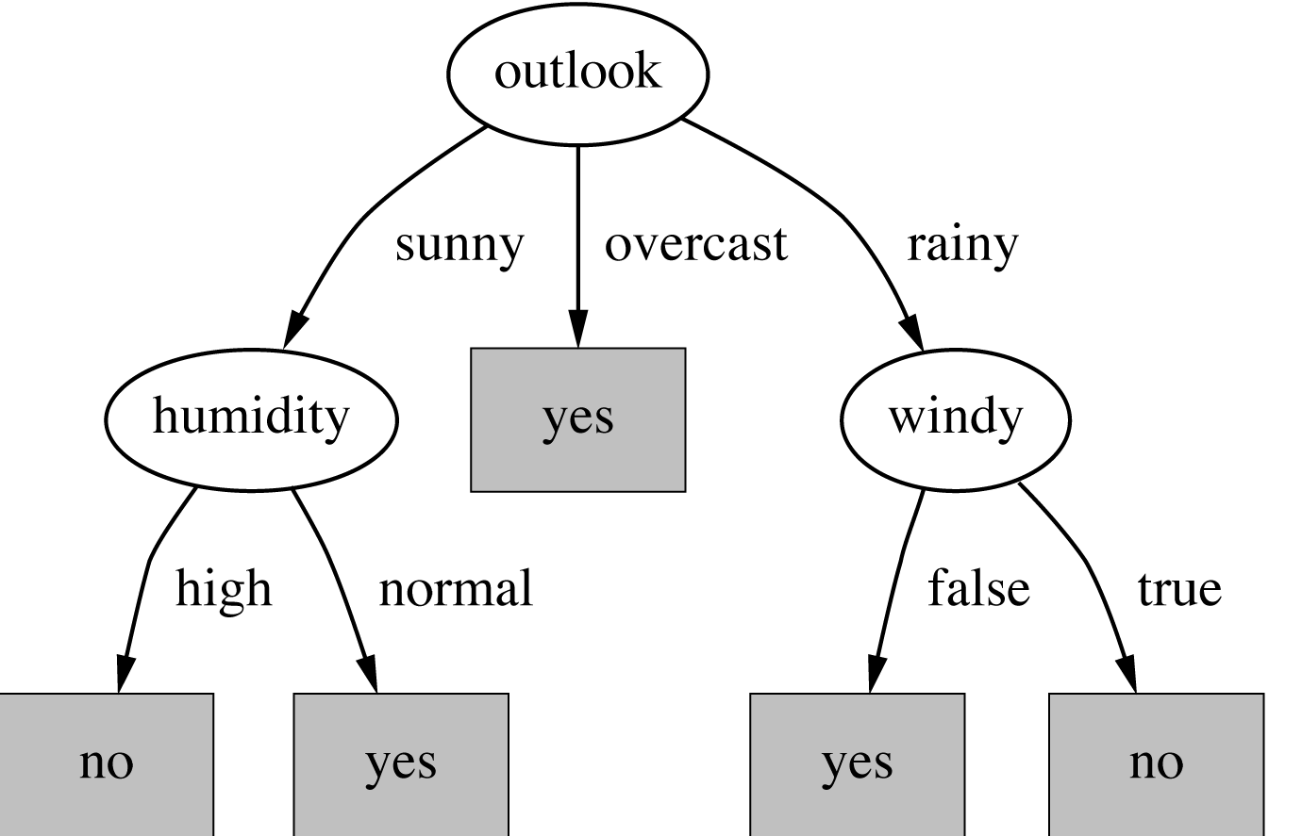
Information Gain Continued
Where to split next?
Final Tree
gain(Temperature ) = 0.571 bits
gain(Humidity ) = 0.971 bits
gain(Windy ) = 0.020 bits
Biased towards choosing attributes with a large number of values ➔ OVERFITTING!

Slide 15
Nearest neighbors
kNN Algorithm

Slide 16
The k-Nearest Neighbor Algorithm
All instances correspond to points in the n-D space
The nearest neighbor are defined in terms of Euclidean distance, dist(X₁, X₂)
Target function could be discrete- or real- valued
For discrete-valued, k-NN returns the most common value among the k training examples nearest to x_{q}
Vonoroi diagram: the decision surface induced by 1-NN for a typical set of training examples
_
.
.
_
_
+
_
.
.
+
.
_
x_{q}
+
_
.
+

Slide 17

The k-Nearest Neighbor Algorithm
k-NN for real-valued prediction for a given unknown tuple
Calculate the mean values of the k nearest neighbors
Distance-weighted nearest neighbor algorithm
Weight the contribution of each of the k neighbors according to their distance to the query x_{q}
Give greater weight to closer neighbors
Robust to noisy data by averaging k-nearest neighbors
Curse of dimensionality: distance between neighbors could be dominated by irrelevant attributes
To overcome it, axes stretch or elimination of least relevant attributes
How kNN Works

Slide 18
The k-Nearest Neighbor Algorithm
Euclidean Distance
Where n is the number of dimensions (attributes) and p_{k} and q_{k} are, respectively, the k^{th} attributes (components) or data objects p and q.
Distance Matrix

Slide 19
Lab in R: K Nearest neighbor

Slide 20
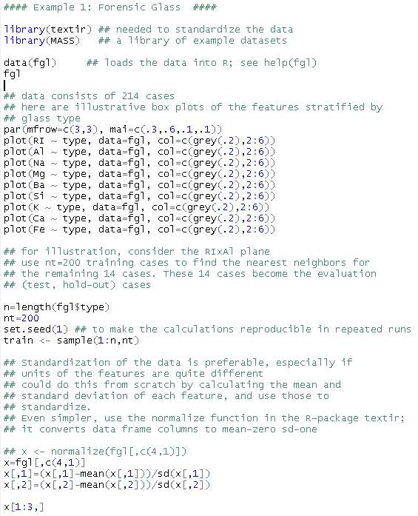
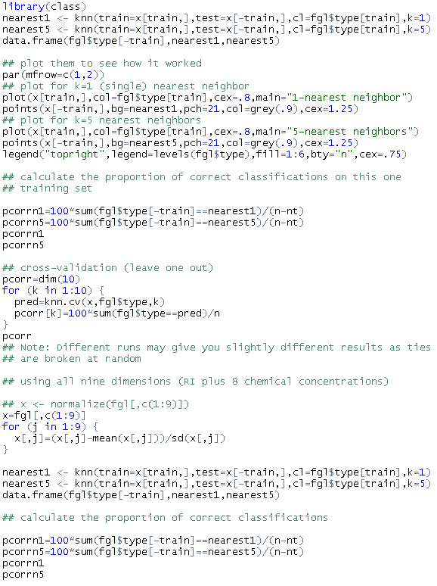
Lab 3 in R: K NEAREST NEIGHBOR
Example 1: Forensic Glass Data

Slide 21
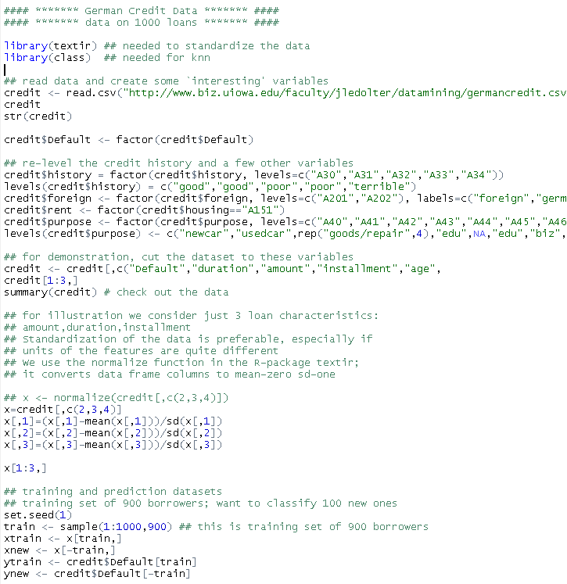
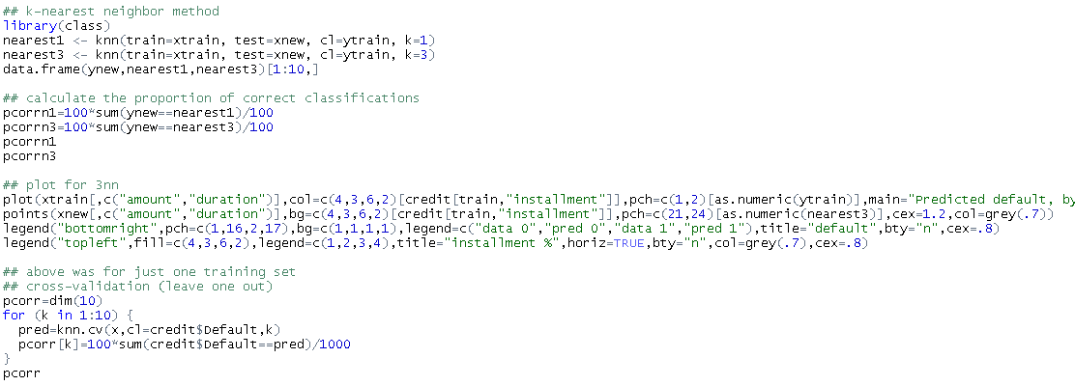
Lab 3 in R: K NEAREST NEIGHBOR
Example 2: German Credit Data

Slide 22
Agenda
# | Topic | Reading | Due Sunday 11:59 pm CST on Blackboard
8 | Classification: Ensemble Learning, Neural Networks/ Deep Learning, Random Forest | Han/ Kamber 9.1-9.5 Witten/Eibe 6,8,11.4 Zhao 4 Zacharski 5 Random Forest with h2o (Tutorial) OR Deep Learning with h2o (Tutorial) Weka Text Classification for First Time & Beginner Users Other YouTube videos as posted | MW Quiz 8: Neural Networks, Random Forest S: FINAL_PROJECT_8: Run your dataset through Neural Networks and Bagging algorithms in EITHER R or Python AND in h2o (use the tutorials as your technical guide). How do the results compare to your previous classification analysis?

Slide 23
Random forest

Slide 24
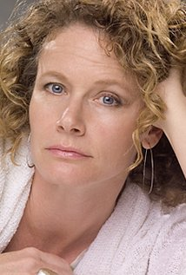
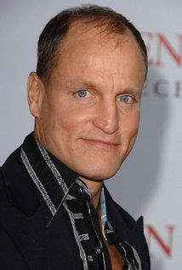
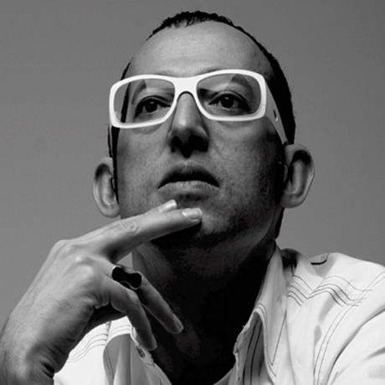
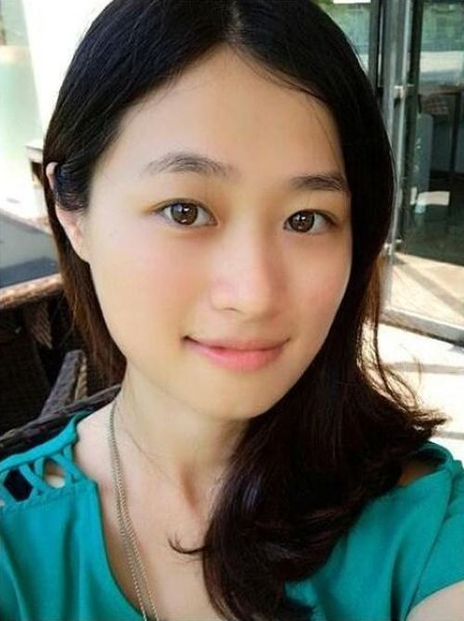
Random Forest: Introduction
Whenever you want to watch a movie, you ask your friend Ashley if she thinks you’ll like it. To help Ashley decide for you, you give her some movies and tell her whether you liked each one or not (i.e., you give her a labeled training set). This makes Ashley your decision tree.
Then, when you ask her if she thinks you’ll like movie X or not, she plays a 20 questions-like game with IMDB, asking questions like “Is X a romantic movie?”, “Does Johnny Depp star in X?”, and so on. She asks more informative questions first (i.e., she maximizes the information gain of each question), and gives you a yes/no answer at the end.
But Ashley is only human, so she doesn’t always generalize your preferences very well (i.e., she overfits).
In order to get more accurate recommendations, you’d like to ask more friends and watch movie X if most of them say they think you’ll like it. That is, instead of asking only Ashley, you want to ask Woody, Apple, and Rashid as well, and they vote on whether you’ll like a movie (i.e., you build an ensemble classifier, aka a forest in this case).

Slide 25





Random Forest: Introduction
You don’t want each of your friends to do the same thing and give you the same answer, so you first give each of them slightly different data.*
So instead of giving your friends the same data you gave Ashley, you give them slightly different versions. You don’t change your love/hate decisions, you just say you love/hate some movies a little more or less (formally, you give each of your friends a bootstrapped version of your original training data). For example, you tell Ashley that you liked Black Swan and Harry Potter and disliked Avatar, and Woody that you watched Black Swan twice, you disliked Avatar, and don’t mention Harry Potter at all.
By using this ensemble, you hope that while each of your friends gives somewhat idiosyncratic recommendations (Ashley thinks you like vampire movies more than you do, Woody thinks you like Pixar movies, and Rashid thinks you just hate everything), the errors get canceled out in the majority. Thus, your friends now form a bagged (bootstrap aggregated) forest of your movie preferences.
Notes:
After all, you’re not absolutely sure of your preferences yourself – you told Ashley you loved Titanic, but maybe you were just happy that day because it was your birthday, so maybe some of your friends shouldn’t use the fact that you liked Titanic in making their recommendations. Or maybe you told her you loved Cinderella, but actually you really really loved it, so some friends should weight Cinderella more.

Slide 26

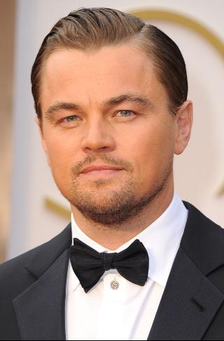
Random Forest: Introduction
There’s still one problem with your data, however. While you loved both Titanic and Inception, it wasn’t because you like movies that star Leonardio DiCaprio. Maybe you liked both movies for other reasons. Thus, you don’t want your friends to all base their recommendations on whether Leo is in a movie or not. So when each friend asks IMDB a question, only a random subset of the possible questions is allowed (i.e., when you’re building a decision tree, at each node you use some randomness in selecting the attribute to split on, say by randomly selecting an attribute or by selecting an attribute from a random subset).
This means your friends aren’t allowed to ask whether Leonardo DiCaprio is in the movie whenever they want. So whereas previously you injected randomness at the data level, by perturbing your movie preferences slightly, now you’re injecting randomness at the model level, by making your friends ask different questions at different times.
And so your friends now form a random forest.

Slide 27
Build Ensemble Classifiers
Basic idea: Build different “experts”, and let them vote
Predict class label for unseen data by aggregating a set of predictions (classifiers learned from the training data).
Advantages:
Improve predictive performance
Other types of classifiers can be directly included
Easy to implement
Disadvantages:
The combined classifier is not so transparent
Not a compact representation
The General Idea
S
Training Data
S₁
S₂
S_{n}
Multiple Data Sets
Multiple Classifiers
C₁
C₂
C_{n}
Combined Classifier
H
Boosting
(Freund and Schapire 1995, Friedman et al. 1998,…)
Bagging
(Breiman 1994,…)
Random Forests
(Breiman 2001,…)

Slide 28
Bagging (= Bootstrap Aggregating)
Training
Bagging works because it reduces variance by voting/averaging
Given a dataset S, at each iteration i, a training set Si is sampled with replacement from S (i.e. bootstrapping)
A classifier Ci is learned for each Si
Classification: Given an unseen sample X,
Each classifier Ci returns its class prediction
The bagged classifier H counts the votes and assigns the class with the most votes to X
Regression: can be applied to the prediction of continuous values by taking the average value of each prediction.
In some pathological hypothetical situations the overall error might increase
Usually, the more classifiers the better
Problem: we only have one dataset.
Solution: generate new ones of size n by bootstrapping, i.e. sampling it with replacement

Slide 29

Why do they work?
Suppose there are 25 base classifiers
Each classifier has error rate,
Assume independence among classifiers
Probability that the ensemble classifier makes a wrong prediction:

Slide 30
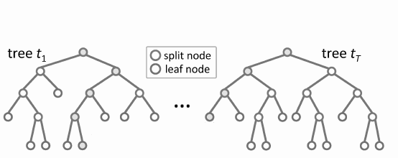
Random Forests
Random forests (RF) are a combination of tree predictors
Each tree depends on the values of a random vector sampled in dependently
The generalization error depends on the strength of the individual trees and the correlation between them
Given a training set S
For i = 1 to k do:
Build subset Si by sampling with replacement from S
Learn tree Ti from Si
At each node:
Choose best split from random subset of F features
Each tree grows to the largest extend, and no pruning
Make predictions according to majority vote of the set of k trees.

Slide 31
Features of Random Forests
It is unexcelled in accuracy among current algorithms.
It runs efficiently on large data bases.
It can handle thousands of input variables without variable deletion.
It gives estimates of what variables are important in the classification.
It generates an internal unbiased estimate of the generalization error as the forest building progresses.
It has an effective method for estimating missing data and maintains accuracy when a large proportion of the data are missing.
It has methods for balancing error in class population unbalanced data sets.
Generated forests can be saved for future use on other data.
Prototypes are computed that give information about the relation between the variables and the classification.
It computes proximities between pairs of cases that can be used in clustering, locating outliers, or (by scaling) give interesting views of the data.
The capabilities of the above can be extended to unlabeled data, leading to unsupervised clustering, data views and outlier detection.
It offers an experimental method for detecting variable interactions.

Slide 32
Lab 1 in R: random Forest

Slide 33

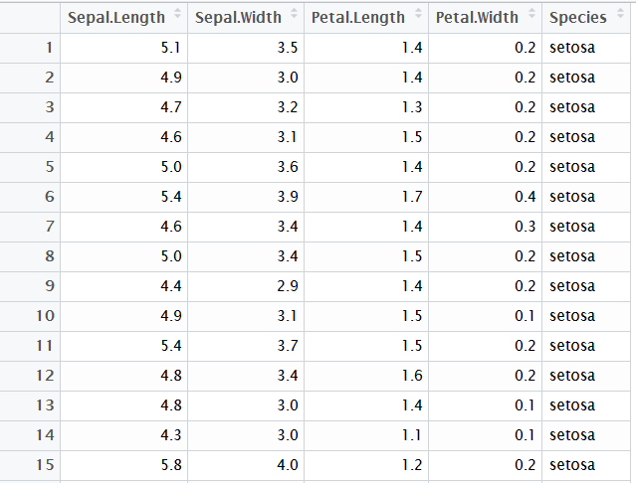
The Example Dataset
The Iris flower data set or Fisher's (or Anderson’s) Iris data set is a multivariate data set initially collected to quantify the morphologic variation of Iris flowers of three related species. The data set consists of 50 samples from each of three species of Iris (Iris setosa, Iris virginica and Iris versicolor). Four features were measured from each sample: the length and the width of the sepals and petals, in centimetres.

Slide 34
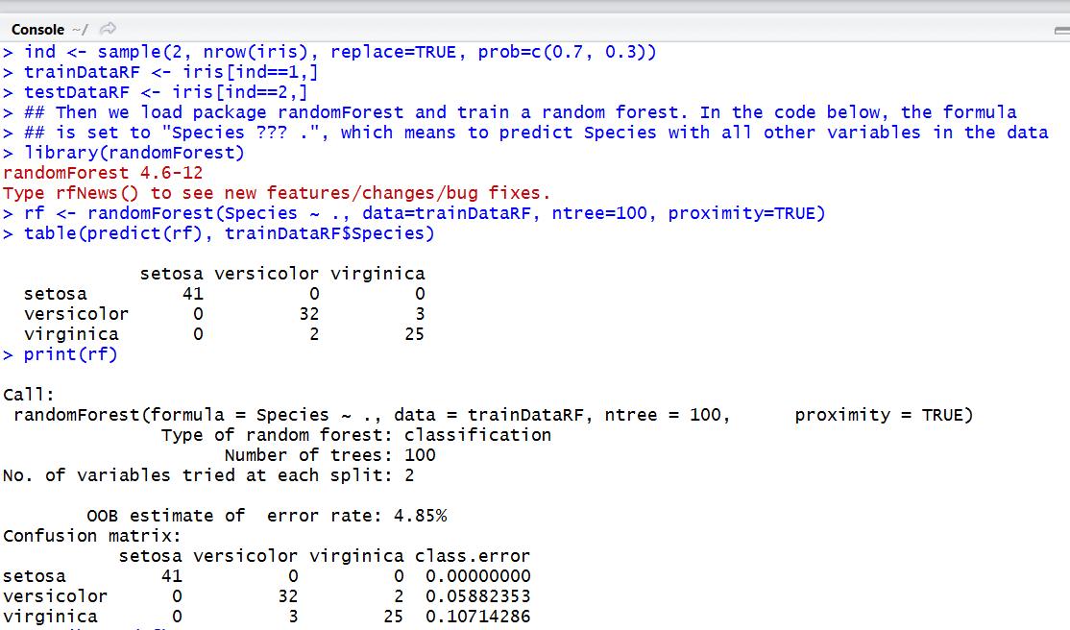
Random Forest

Slide 35
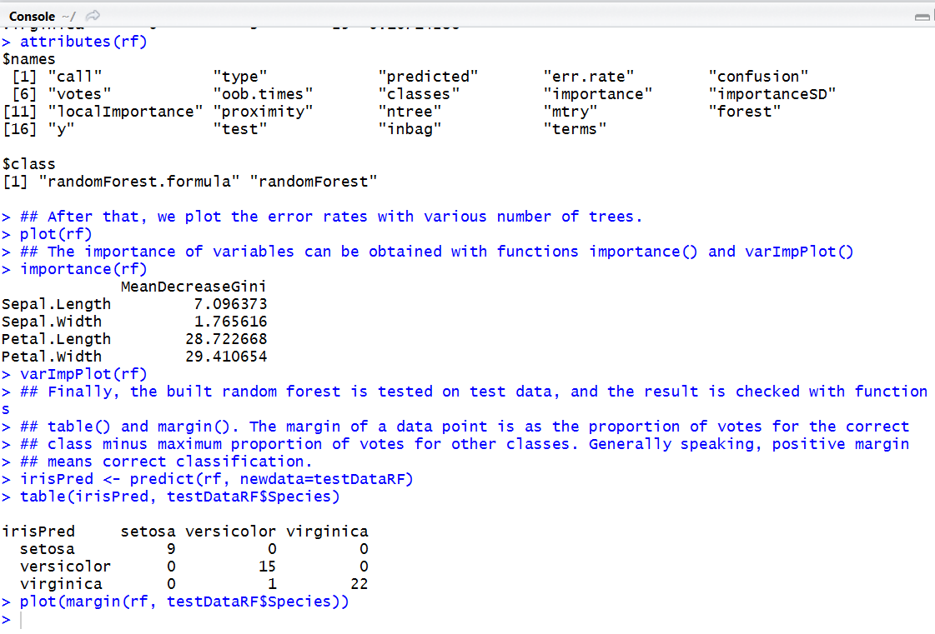
Random Forest

Slide 36
Agenda
# | Topic | Reading | Due Sunday 11:59 pm CST on Blackboard
8 | Classification: Ensemble Learning, Neural Networks/ Deep Learning, Random Forest | Han/ Kamber 9.1-9.5 Witten/Eibe 6,8,11.4 Zhao 4 Zacharski 5 Random Forest with h2o (Tutorial) OR Deep Learning with h2o (Tutorial) Weka Text Classification for First Time & Beginner Users Other YouTube videos as posted | MW Quiz 8: Neural Networks, Random Forest S: FINAL_PROJECT_8: Run your dataset through Neural Networks and Bagging algorithms in EITHER R or Python AND in h2o (use the tutorials as your technical guide). How do the results compare to your previous classification analysis?

Slide 37
Lab 1 in h2o: random Forest

Slide 38
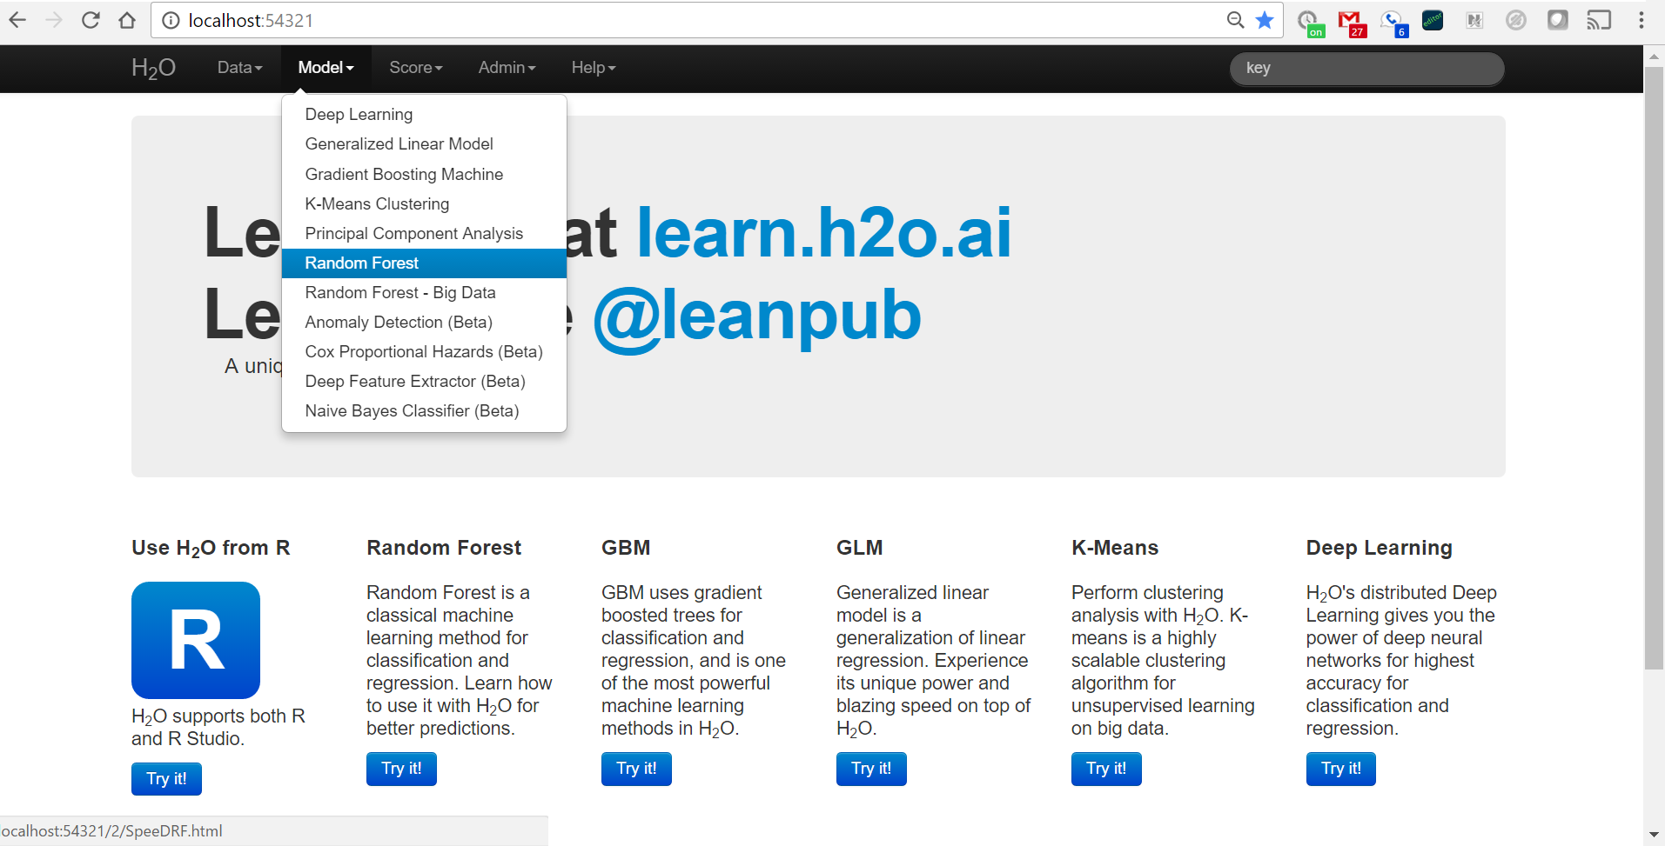
Random Forest in h2o (v. 2.8)

Slide 39
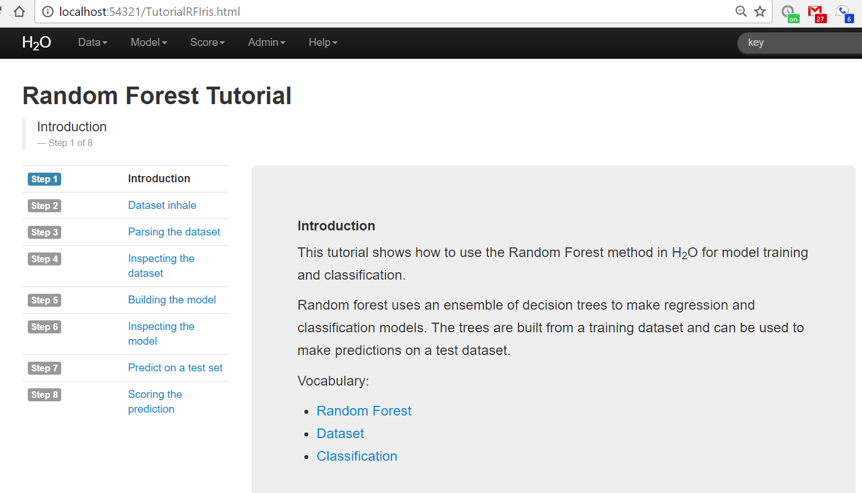
Random Forest in h2o (v. 2.8)

Slide 40
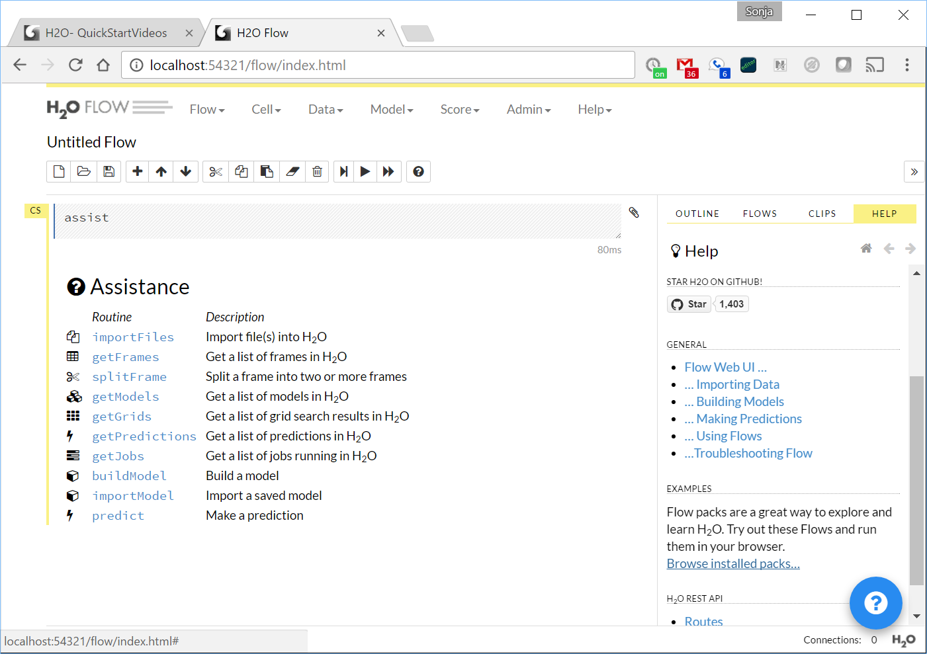
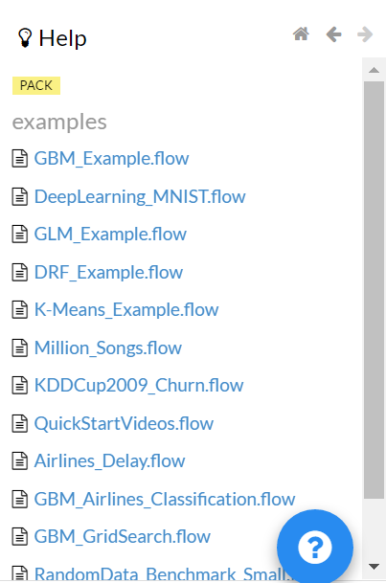
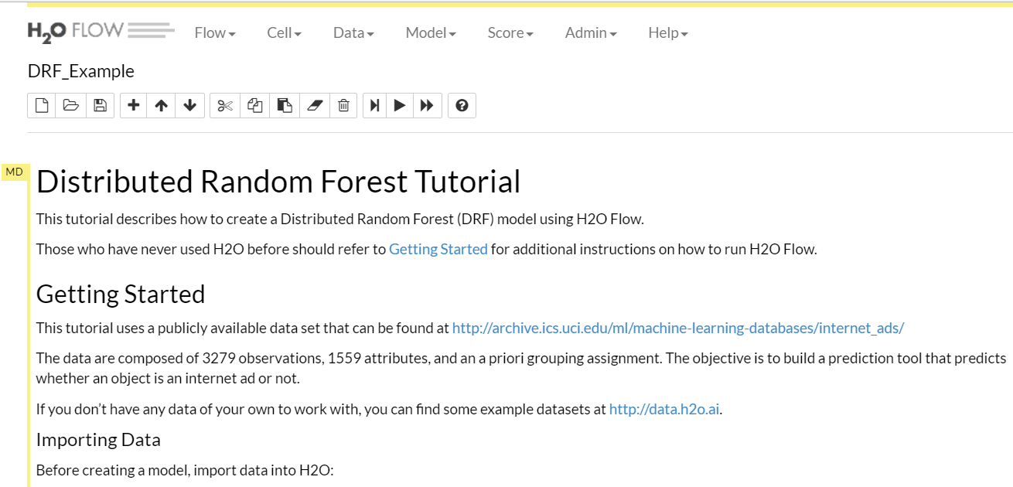
Random Forest in h2o (v. 3.10)
Distributed Random Forest

Slide 41
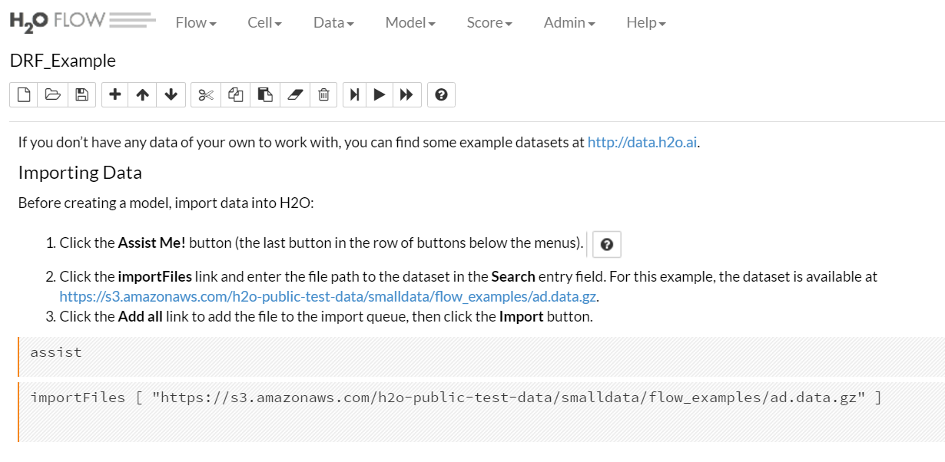
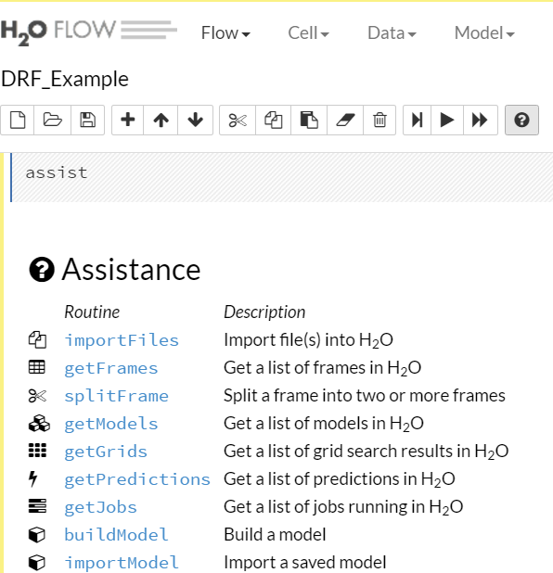
Random Forest in h2o (v. 3.10)
File Path:
https://s3.amazonaws.com/h2o-public-test-data/smalldata/flow_examples/ad.data.gz

Slide 42
Neural networks and deep learning

Slide 43
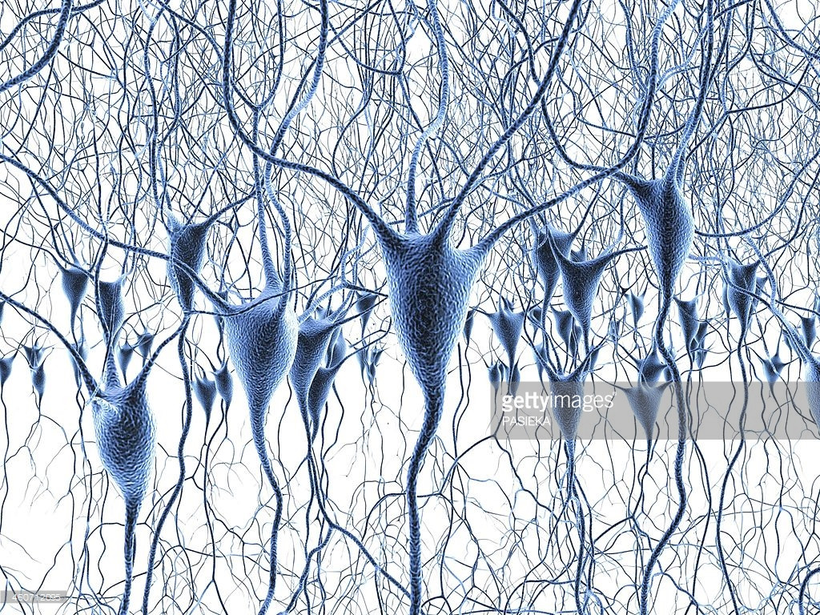
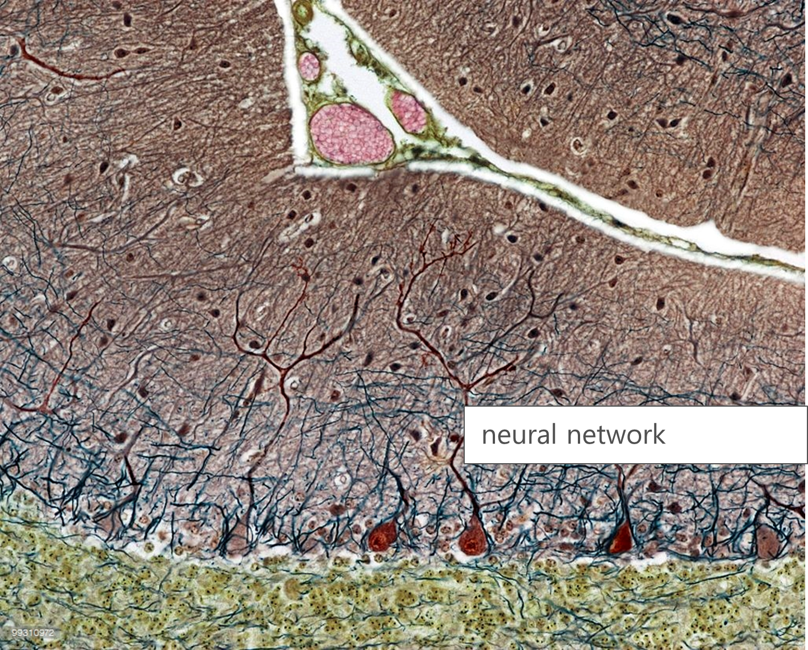

Modeled on the Brain
neural network
Nodes (=soma) aggregate information from dendrites and pass it on through the axon (=stem). Axons are connected to other dendrites with synapses.
synapse

Slide 44
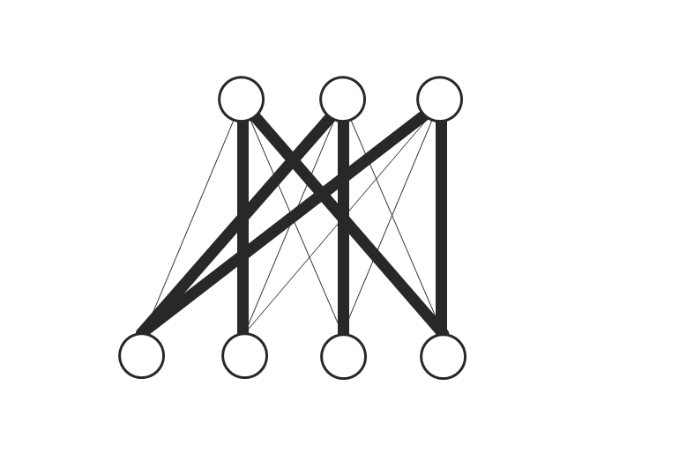
Neural Network
sunglasses
eyeball
eyeglasses
Lots of axons connect with the dendrites of one neuron.
eye
sun
ball
glasses
Each connection has its own strength.

Slide 45
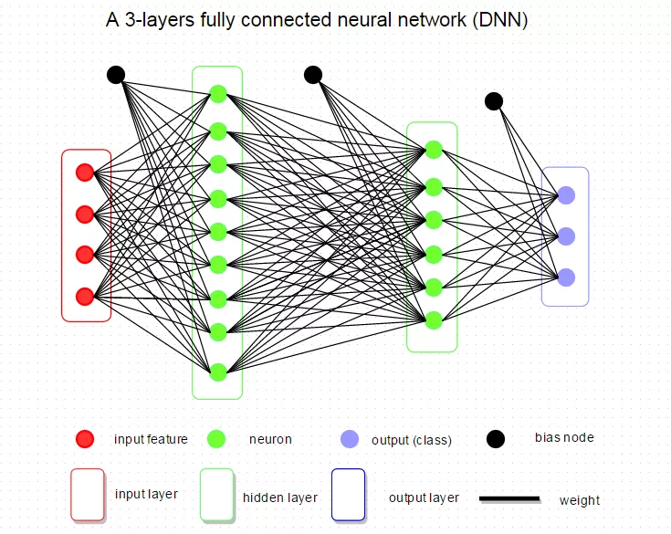
Neural Network
Multi-layer, feedforward neural networks consist of many layers of interconnected neuron units, starting with an input layer to match the feature space, followed by multiple layers of nonlinearity, and ending with a linear regression or classification layer to match the output space.
Bias units are included in each non-output layer of the network. The weights linking neurons and biases with other neurons determine the output of the entire network. Learning occurs when these weights are adapted to minimize the error on the labeled training data. For each training example j, the goal is to minimize a loss function,
L(W, B | j).
Here, W is the collection {Wi}_{1:N−1} , where Wi denotes the weight matrix connecting layers i and i + 1 for a network of N layers. Similarly B is the collection {bi}_{1:N−1} , where bi denotes the column vector of biases for layer i + 1

Slide 46
Neural Network & Backpropagation
The Backpropagation Algorithm iteratively learns a set of weights for prediction of the class label of tuples
It performs learning on a multilayer feed-forward neural network (Multilayer Perceptron) = Set of input/output units where each connection has a weight associated with it
During the learning phase, the network learns by adjusting the weights so as to be able to predict the correct class label of the input tuples
Started by psychologists and neurobiologists
Weakness
Long training time
Require a number of parameters typically best determined empirically, e.g., the network topology or “structure."
Poor interpretability: Difficult to interpret the symbolic meaning behind the learned weights and of “hidden units" in the network
Strength
High tolerance to noisy data
Ability to classify untrained patterns
Well-suited for continuous-valued inputs and outputs
Successful on a wide array of real-world data
Algorithms are inherently parallel
Techniques have recently been developed for the extraction of rules from trained neural networks

Slide 47
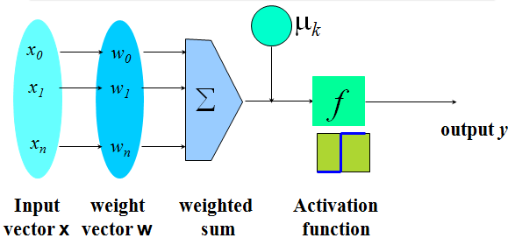
Neuron: A Hidden/Output Layer Unit
2
1
Feed-forward
3a
3b
Backpropagation
3c + d
Initialize weights with random values
Feed the input tuples into the network one by one
For each unit
Compute the net input to the unit as a linear combination of all the inputs to the unit
Compute the output value using the activation function (=feed-forward)
Compute the error
Update the weights and the bias (= backpropagation)
Goal: Obtain a set of weights that makes almost all the tuples in the training data classified correctly

Slide 48
Backpropagation Algorithm
Iteratively process a set of training tuples & compare the network's prediction with the actual known target value
For each training tuple, the weights are modified to minimize the mean squared error between the network's prediction and the actual target value and then updated for the next epoch.
Efficiency: Each epoch (one iteration through the training set) takes O(|D| * w), with |D| tuples and w weights, but # of epochs can be exponential to n, the number of inputs, in worst case
Rule extraction by network pruning:
Simplify network structure by removing weighted links that have the least effect on the trained network
Then aggregate link, unit, or activation values
Study the set of input and activation values to derive rules describing the relationship between the input and hidden unit layers
Sensitivity analysis: Assess the impact that a given input variable has on a network output. The knowledge gained from this analysis can be represented in rules

Slide 49
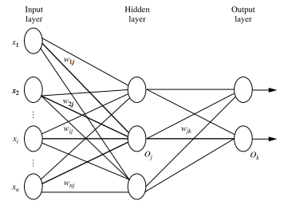
Defining a Network Topology
First decide the network topology: # of units in the input layer, # of hidden layers (if > 1), # of units in each hidden layer, and # of units in the output layer
Normalize input values for each attribute measured in the training tuples to [0.0—1.0]
One input unit per domain value, each initialized to 0
Output, if for classification and more than two classes, one output unit per class is used
Multilayer feed-forward network
If accuracy of trained network is unacceptable, repeat training process with different network topology or different initial weights

Slide 50
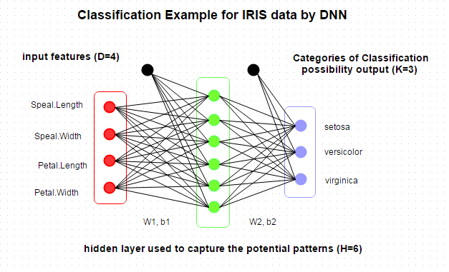
Example: Iris Dataset
See the instructions and explanation at https://www.r-bloggers.com/r-for-deep-learning-i-build-fully-connected-neural-network-from-scratch/

Slide 51
SVM—Support Vector Machines
Classification is essentially finding the best boundary between classes.
Support vector machine finds the best boundary points called support vectors and builds classifier on top of them.
Linear and Non-linear support vector machine.
Features: training can be slow but accuracy is high owing to their ability to model complex nonlinear decision boundaries (margin maximization)
Used for: classification and numeric prediction
Applications: handwritten digit recognition, object recognition, speaker identification, benchmarking time-series prediction tests

Slide 52
Example of General SVM
Method
Uses nonlinear mapping to transform the original training data into a higher dimension
With the new dimension, it searches for the linear optimal separating hyperplane (i.e., “decision boundary”)
With an appropriate nonlinear mapping to a sufficiently high dimension, data from two classes can always be separated by a hyperplane
SVM finds this hyperplane using support vectors (“essential” training tuples) and margins (defined by the support vectors)
The dots with shadows around them are support vectors, i.e. the best data points to represent the boundary (= the curve).

Slide 53
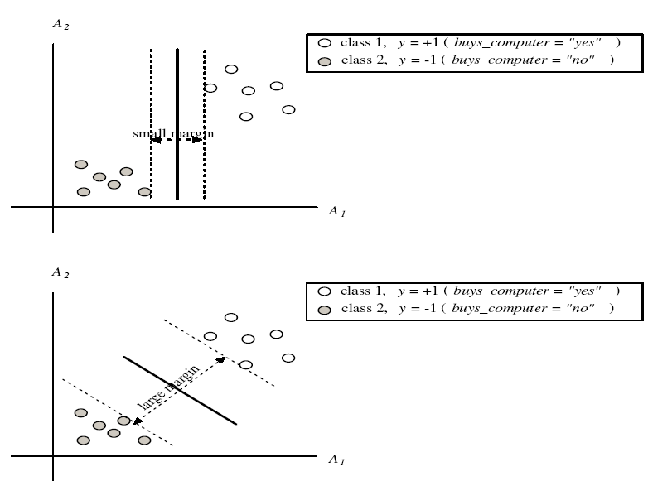
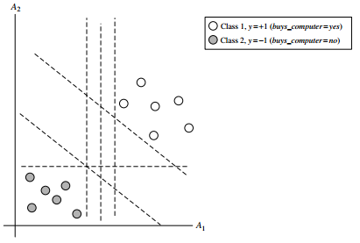
SVM—Margins and Support Vectors
Example: buys_computer
There are infinite lines (hyperplanes) separating the two classes but we want to find the best one (the one that minimizes classification error on unseen data)
SVM searches for the hyperplane with the largest margin, i.e., maximum marginal hyperplane (MMH)
Larger margin = better results

Slide 54
Why Is SVM Effective on High Dimensional Data?
The complexity of trained classifier is characterized by the # of support vectors rather than the dimensionality of the data
The support vectors are the essential or critical training examples —they lie closest to the decision boundary (MMH)
If all other training examples are removed and the training is repeated, the same separating hyperplane would be found
The number of support vectors found can be used to compute an (upper) bound on the expected error rate of the SVM classifier, which is independent of the data dimensionality
Thus, an SVM with a small number of support vectors can have good generalization, even when the dimensionality of the data is high
NOTE: When the data set is non-separable, we will assign
weight to each support vector which will be shown in the constraint or transform the data into another space.

Slide 55
SVM vs. Neural Network
SVM
Neural Network
Relatively new concept
Deterministic algorithm
Nice Generalization properties
Hard to learn – learned in batch mode using quadratic programming techniques
Using kernels can learn very complex functions
Relatively old
Nondeterministic algorithm
Generalizes well but doesn’t have strong mathematical foundation
Can easily be learned in incremental fashion
To learn complex functions—use multilayer perceptron (not that trivial)

Slide 56
Lab 2 in R: neural networks/ deep learning

Slide 57
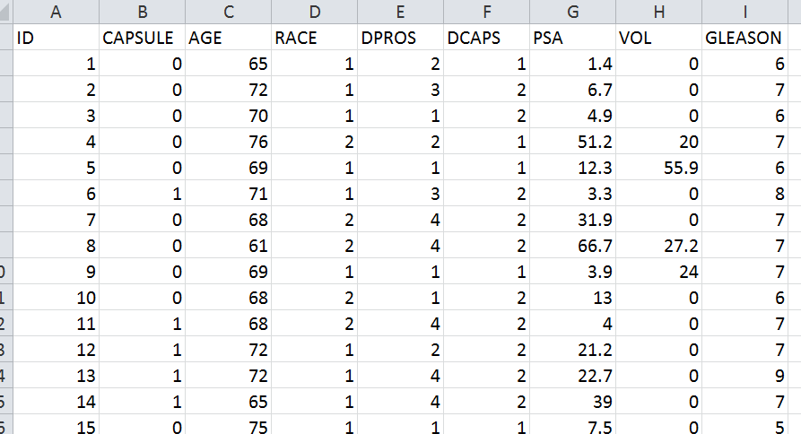
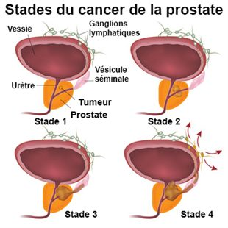
The Example Datasets
Prostate Cancer Dataset
The prostate cancer data set comes from a study by Dr. Donn Young at The Ohio State University Comprehensive Cancer Center of patients with varying degrees of prostate cancer.
The relevant columns are CAPSULE (binary variable indicating tumor penetration of prostatic capsule), AGE (in years), RACE (1 = white, 2 = black), PSA (prostatic-specific antigen value), and GLEASON (total gleason score, indicating how aggressive the cancer is).

Slide 58
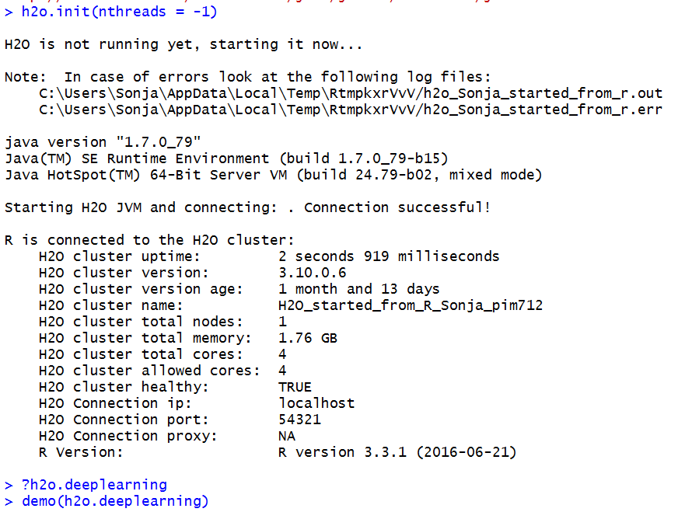
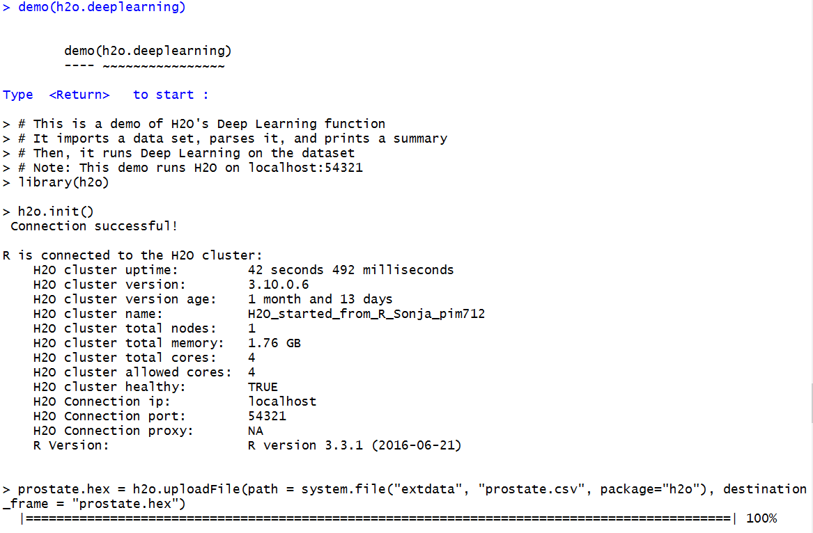
Example: Prostate Dataset

Slide 59
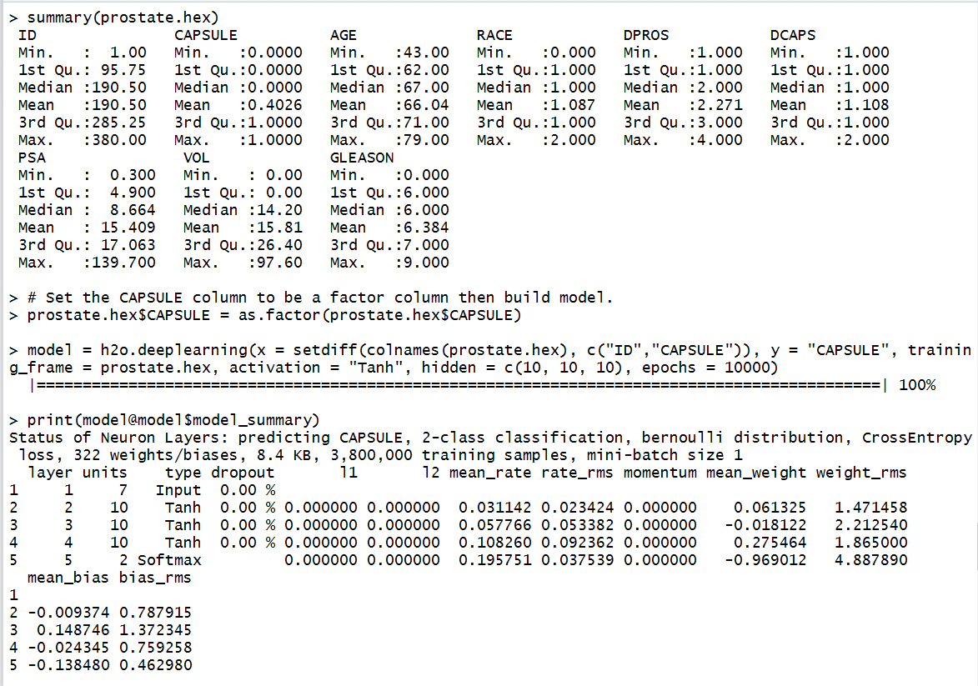
Example: Prostate Dataset

Slide 60
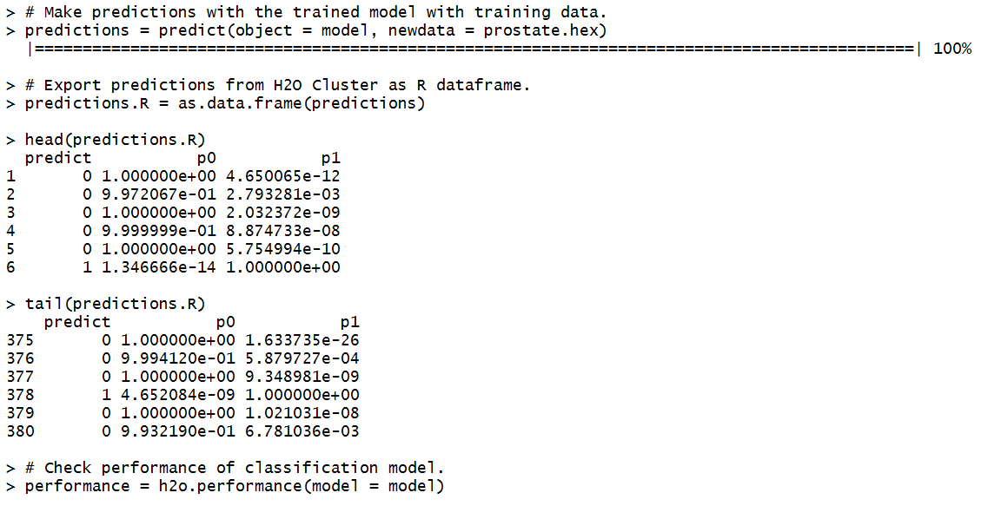
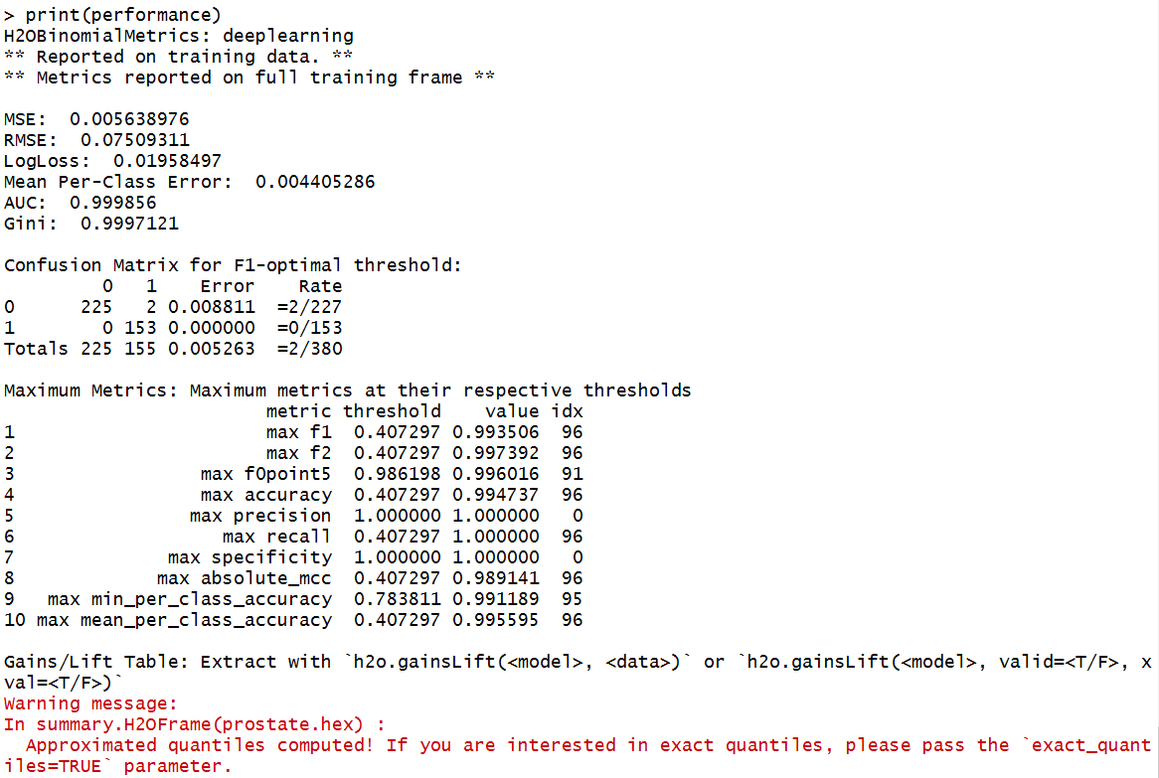
Example: Prostate Dataset

Slide 61
Example: Iris Dataset
Code described here:
http://h2o-release.s3.amazonaws.com/h2o/rel-lambert/5/docs-website/Ruser/rtutorial.html

Slide 62
Lab 2 in h2o: neural networks/ deep learning

Slide 63
Deep Learning in h2o (v. 3.10)
Deep Learning

Slide 64
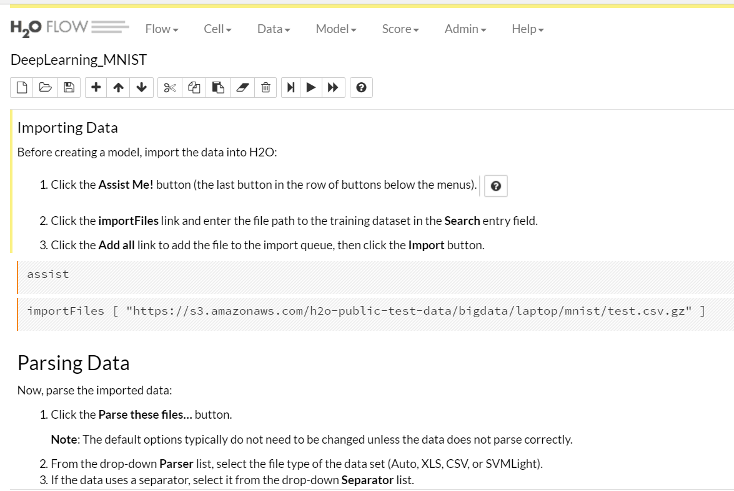
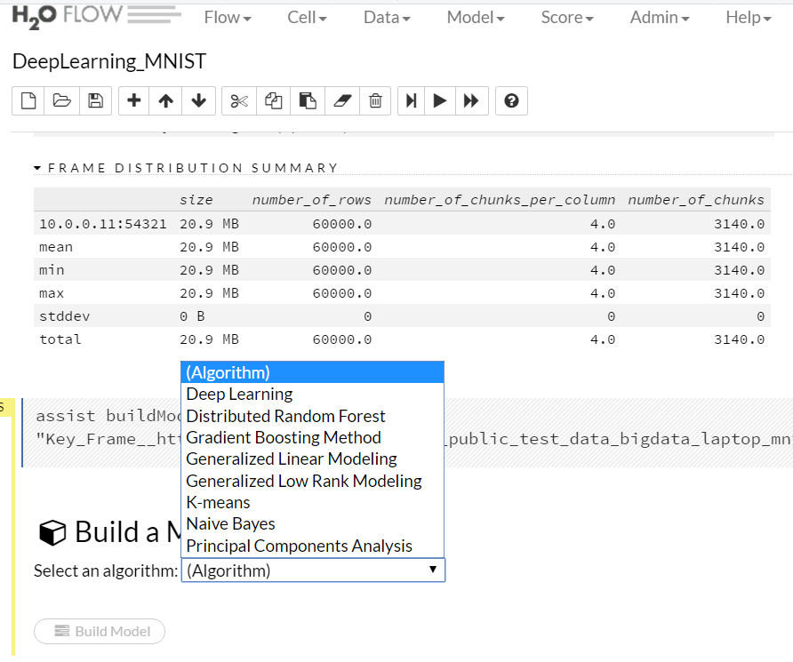
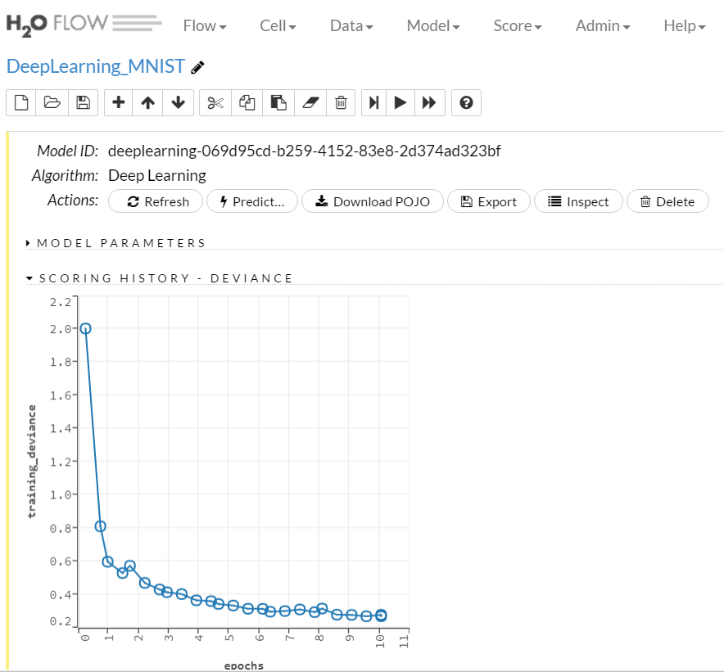
Deep Learning in h2o (v. 3.10)
Deep Learning result in h2o. Default epochs are set to 10; generating the result to the left took 41 iterations and 6 min.

Slide 65
prediction

Slide 66
What Is Prediction?
(Numerical) prediction is similar to classification
construct a model
use model to predict continuous or ordered value for a given input
Prediction is different from classification
Classification refers to predict categorical class label
Prediction models continuous-valued functions
Major method for prediction: regression
model the relationship between one or more independent or predictor variables and a dependent or response variable
Regression analysis
Linear and multiple regression
Non-linear regression
Other regression methods: generalized linear model, Poisson regression, log-linear models, regression trees

Slide 67
Linear Regression
Linear regression: involves a response variable y and a single predictor variable x
y = w₀ + w₁ x
where w₀ (y-intercept) and w₁ (slope) are regression coefficients
Method of least squares: estimates the best-fitting straight line
Multiple linear regression: involves more than one predictor variable
Training data is of the form (X₁, y₁), (X₂, y₂),…, (X_{|D|}, y_{|D|})
Ex. For 2-D data, we may have: y = w₀ + w₁ x₁+ w₂ x₂
Solvable by extension of least square method or using SAS, S-Plus
Many nonlinear functions can be transformed into the above

Slide 68
Nonlinear Regression
Some nonlinear models can be modeled by a polynomial function
A polynomial regression model can be transformed into linear regression model. For example,
y = w₀ + w₁ x + w₂ x² + w₃ x³
convertible to linear with new variables: x₂ = x², x₃= x³
y = w₀ + w₁ x + w₂ x₂ + w₃ x₃
Other functions, such as power function, can also be transformed to linear model
Some models are intractable nonlinear (e.g., sum of exponential terms)
possible to obtain least square estimates through extensive calculation on more complex formulae

Slide 69
Other Regression-Based Models
Generalized linear model:
Foundation on which linear regression can be applied to modeling categorical response variables
Variance of y is a function of the mean value of y, not a constant
Logistic regression: models the prob. of some event occurring as a linear function of a set of predictor variables
Poisson regression: models the data that exhibit a Poisson distribution
Log-linear models: (for categorical data)
Approximate discrete multidimensional prob. distributions
Also useful for data compression and smoothing
Regression trees and model trees
Trees to predict continuous values rather than class labels

Slide 70
Regression Trees and Model Trees
Regression tree: proposed in CART system (Breiman et al. 1984)
CART: Classification And Regression Trees
Each leaf stores a continuous-valued prediction
It is the average value of the predicted attribute for the training tuples that reach the leaf
Model tree: proposed by Quinlan (1992)
Each leaf holds a regression model—a multivariate linear equation for the predicted attribute
A more general case than regression tree
Regression and model trees tend to be more accurate than linear regression when the data are not represented well by a simple linear model

Slide 71
Predictive Modeling in Multidimensional Databases
Predictive modeling: Predict data values or construct generalized linear models based on the database data
One can only predict value ranges or category distributions
Method outline:
Minimal generalization
Attribute relevance analysis
Generalized linear model construction
Prediction
Determine the major factors which influence the prediction
Data relevance analysis: uncertainty measurement, entropy analysis, expert judgement, etc.
Multi-level prediction: drill-down and roll-up analysis

Slide 72
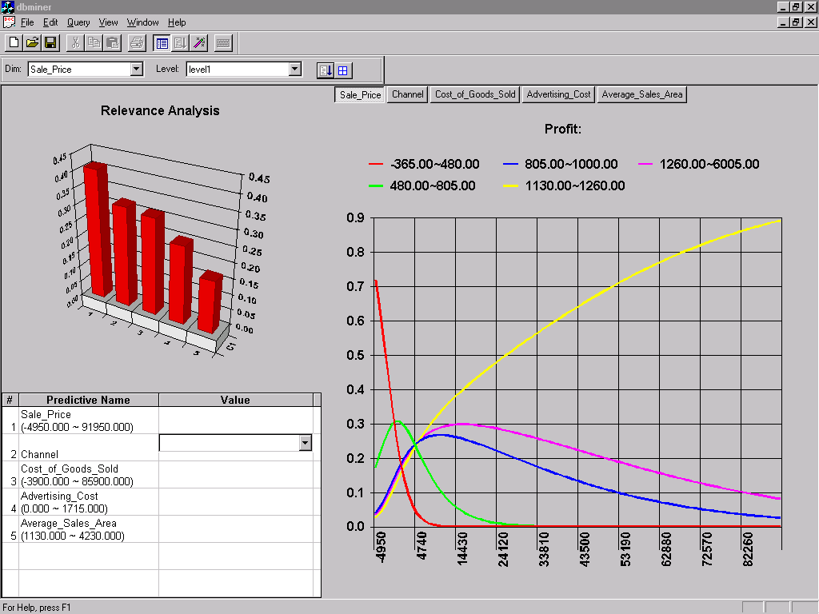
Prediction: Numerical Data

Slide 73

Prediction: Categorical Data

Slide 74
Lab 3 in R: generalized linear modeling

Slide 75


The Example Datasets
The body composition of 71 healthy subjects was measured by Dual Energy X-Ray Absorptiometry (DXA). This reference method is very accurate in measuring body fat but finds little applicability in practical environments, mainly because of high costs and the methodological efforts needed. Therefore, a simple equation for predicting DXA measurements of body fat is of special interest for the practitioner.
A data frame with 71 observations on the following 10 variables.
Age--age in years.
DEXfat--body fat measured by DXA,
Waistcirc--waist circumference.
Hipcirc--hip circumference.
Elbowbreadth--breadth of the elbow.
Kneebreadth--breadth of the knee.
7-10. Anthro3a-4--sum of logarithm of three anthropometric measurements.

Slide 76


Example1: Generalized Linear Modeling

Slide 77


Example1: Generalized Linear Modeling

Slide 78
The Example Datasets
Prostate Cancer Dataset
The prostate cancer data set comes from a study by Dr. Donn Young at The Ohio State University Comprehensive Cancer Center of patients with varying degrees of prostate cancer.
The relevant columns are CAPSULE (binary variable indicating tumor penetration of prostatic capsule), AGE (in years), RACE (1 = white, 2 = black), PSA (prostatic-specific antigen value), and GLEASON (total gleason score, indicating how aggressive the cancer is).

Slide 79

Example2: Generalized Linear Modeling with h2o

Slide 80
Lab 3 in h2o: generalized linear modeling

Slide 81

Generalized Linear Modeling in h2o (v. 3.10)
Generalized Linear Modeline

Slide 82
Old weka exercises

Slide 83
WEKA
Lab_0: Attribute Quality

Slide 84



Weka Explorer: Setting Up
Open Weka Data file “weather-nominal.arff”

Slide 85



Weka Explorer: Select Attributes Screen
Available Attribute Functions
Single attribute evaluators
Attribute subset evaluators
Attribute set evaluators
Most of these are supervised!

Slide 86


Available Attribute Evaluators and Methods

Slide 87


Weather Dataset Attributes--InformationGainAttributeEval
InfoGainAttributeEval sets Ranker Method automatically!
Define class
Hit “Start’
Ranks attributes by information gain

Slide 88

Weather Dataset Attributes--GainRatioAttributeEval
Ranks attributes by gain ratio (see Witten ch. 6)

Slide 89
Lab Exercise
Run Information Gain on the “segment” dataset—what is the attribute ranking? Why?
Then run GainRatio on the “segment” dataset—what is the attribute ranking? Why is it different from Information Gain?

Slide 90
Weka Lab 1
Multilayer Perceptron vs. Support Vector

Slide 91


Lab 1: Multilayer Perceptron
Open the segment-challenge.arff data file
Set segment-test.arff as the supplied test set
In the Classify Tab, find Multilayer Perceptron under ‘functions”
Investigate configuration options and Capabilities.

Slide 92


Lab 1: Multilayer Perceptron
Run with defaults.
Then run again, but turn GUI on to monitor backpropagation.

Slide 93

Lab 1: Multilayer Perceptron
Investigate network view
Play with adjusting Learning Rate and Momentum to see how the Neural Network changes
Then insert random weights (by clicking in the area between the green labels and the red points) and hit Start to recalculate.
Monitor output changes in the main panel.

Slide 94


Lab 1: Support Vector Machine
Both, LibSVM and SMO implement Support Vector Machines.
LibSVM requires classpath adjustments (ext. library)
Select SMO and review the Capabilities and Configuration options.
Run it.

Slide 95

Lab 1: Support Vector Machine
Install LibSVM from http://www.csie.ntu.edu.tw/~cjlin/libsvm/ based on the instructions at https://www.youtube.com/watch?v=jFLbhwgNggQ
Familiarize yourself with the configuration options.
Run it.
Compare the results of Neural Network vs. SMO and/ or LibSVM. How can you tune either one of these to achieve better results?
What is their advantage over BayesNet?

Slide 96
Weka Lab 2: kNN
K Nearest Neighbor Algorithm

Slide 97

Lab 2: kNN Algorithm
Open the segment-challenge.arff data file
Set segment-test.arff as the supplied test set
In the Classify Tab, find Ibk under ‘lazy”
Investigate configuration options and Capabilities.
Run it.

Slide 98

Lab 2: kNN Algorithm
Compare the output to all the algorithms you have run on this dataset:
C4.5 (J48)
Naïve Bayes
Bayesian Belief Networks
Neural Networks (Multilayer Perceptron)
Support Vector Machine (SOM and LibSVM)
kNN
Which algorithm works best for this dataset? Can you figure out why?

Slide 99
For Next Week
# | Topic | Reading | Due Sunday 11:59 pm CST on Blackboard
9 | Clustering: kMeans, Hierarchical Clustering, DBScan | Han/ Kamber 10.1-10.4, 10.6 Witten/Eibe 4.8, 6.8, 11 Zhao 6 Zacharski 8 kMeans Clustering with h2o (Tutorial) YouTube videos as posted | MW Quiz 9: kMeans, Hierarchical Clusterer S: FINAL_PROJECT_9: Preprocess your dataset to run with the kMeans, Hierarchical Clusterer, and DB Scan algorithms. How did you tune each algorithm to achieve optimal results? Which algorithm produces the best results and why?

